Slide 1

PYTHON-POWERED EXCEL
Notes:
Welcome!

Slide 2

George Mount
Data Analyst & Educator at Stringfest Analytics
George works as an independent analyst and data analytics educator with the goal to help clients manage their data so they think more creatively. He serves as a technical expert and lead curriculum developer for Thinkful’s data analytics program and is the instructor of the DataCamp course “Survey and Measure Development in R.”
George blogs about data, innovation, and career development at georgejmount.com. He holds a master’s degree in information systems with a certificate of achievement in quantitative methods from Case Western Reserve University
Notes:
Here’s me, you already learned this.

Slide 3

COURSE OBJECTIVES
Load, view and write workbooks to and from Python
Add custom formats, protections and metadata to workbooks from Python
Navigate and execute code in Jupyter notebooks
Python-Powered Excel
Notes:
All right, we have a ton of stuff to do today so I apologize now if we don’t get through it all.
This is a follow-up from my Excel Statistics for Business Analytics course, so you should be in good shape for this class. You don’t have to have taken it. But I think it will help.
Pulse check on who’s taken it?
We are going to the next level here on this course. In the last course we focused on descriptive statistics, and then made the leap into inferential statistics with the t-test. And in that test we looked for a statistically significant difference in the means of two values.
We are going to go beyond that now and test things like the differences between three or groups, or the same variable at different points in time. We are also going to get into building a basic predictive model using linear regression, and if you’ve ever heard the discussion about the fine line between correlation and causation, we will see those both here.
As always, I want this to be as business-oriented as possible, we will use real-world datasets, and you will learn how to explain and apply this stuff into a business setting so that our non stats-enlightened counterparts can follow along. And one of the best ways to explain something to someone is to draw a picture, and that’s what we’ll do by building data visualizations throughout. They play a crucial role in interpretation, not just for our audience, but for us – as you’ll see, failing to visualize our data can lead to some pretty wild mis-interpretations.

Slide 4
FOLLOWING ALONG
Each section is a sub-folder
Demos = follow along with me
Drills = try it yourself
Refresh your memory with the demo notes
Python-Powered Excel
Notes:
This is an Excel class, so we won’t be looking at PowerPoint the whole time – to follow along, you will see that all assets are divided by section.
Some of our Excel time will be Demos – for this I will be walking through some procedure in Excel.
If you need any datasets they will be included in each sub-folder.
Then there may be a Drill where you will work on it for yourself during some specified period of time.
I have provided written notes/instructions about the Demos which you can refer to while working on the Drills.

Slide 5
1. UP AND RUNNING WITH PYTHON IN EXCEL
Notes:
All right, we are going to jump right into statistical inference, this section is going to help us say things about a population given our samples, but using different “raw ingredients” than we could us for the t-test.
It’s kind of a grab-bag, and the title “expected values and repeated measures” will start to make more sense as we continue.

Slide 6

Python is...
File: housing.xlsx
How would you check for a significant difference in prices of homes with and without air conditioning?
At the 95% confidence level (a constant for the course)
Notes:
OK, let’s just start by jogging our memory on stats. Take a look at this dataset and let me know in the chat what steps you would take to check for a difference in the price of homes with and without air conditioning.
We performed this exact analysis in the earlier Excel class, so hopefully it’s familiar. As you are thinking through what to do, one of the things you might ask would be, at what confidence interval? Give yourself a pat on the back if you asked that, because it’s a key consideration in inferential statistics! And we will continue to use the 95% confidence interval here.
OK, so we aren’t going to conduct that test since we already did it in the last class. But I do want to use it for a jumping-off point as to other things we might want to learn about the data. Let’s take a look at another possible question.

Slide 7
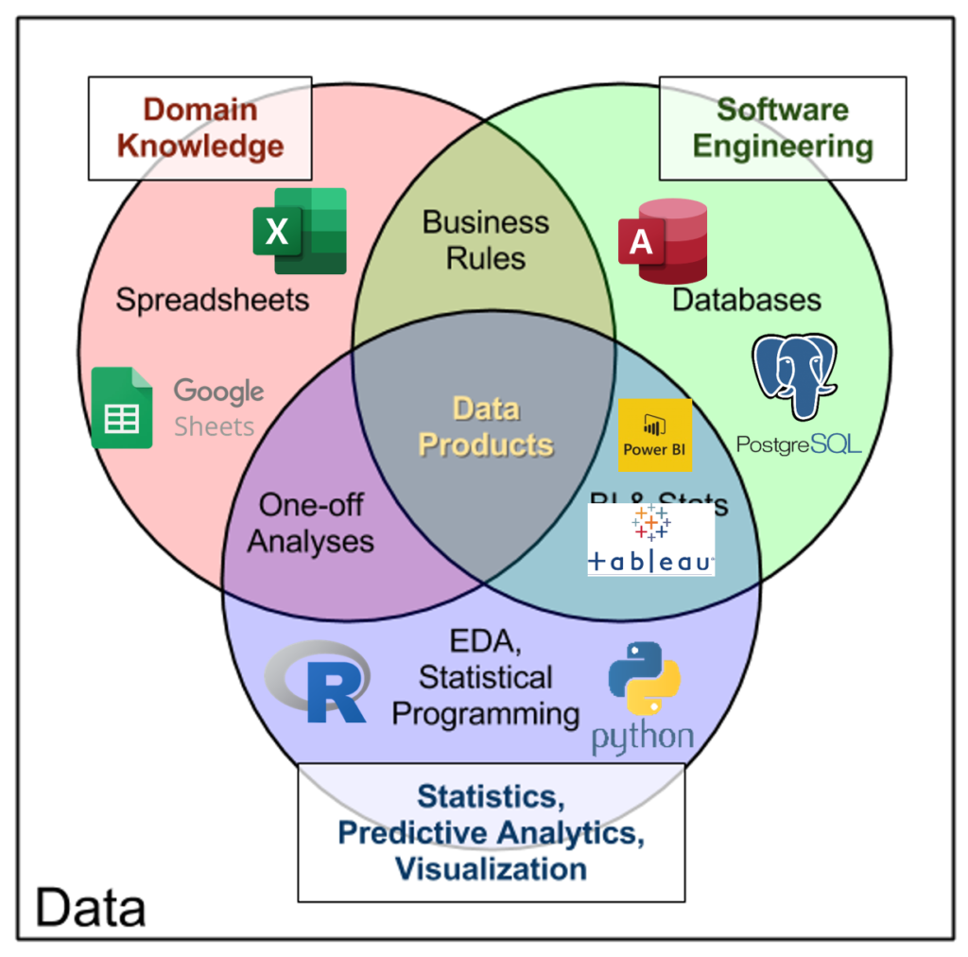
THE DATA ANALYTICS STACK
http://www.datacommunitydc.org/blog/2013/09/the-data-products-venn-diagram
Notes:
OK, let’s recap what actually happened here.

Slide 8

PYTHON & EXCEL: “YES, AND” DATA ANALYSIS
Notes:
https://pixabay.com/photos/children-happy-siblings-hide-play-1879907/
OK, now let’s do another kind of repeated-measures analysis. But this time, we are not going to assume normality, which means we’ll be conducing a non-parametric test.
Let’s do the example first, and then get deeper into the distinction between these two types of statistical tests.

Slide 9
SEE YOU ON JUPYTER
Notes:
And we will do that with what’s called the Wilcoxon signed-rank test.

Slide 10
Warm-up
File: housing.xlsx
How would you check for a significant difference in prices of homes with and without air conditioning?
What about a relationship in homes with air conditioning versus homes with a rec room?
Notes:
OK, maybe I want to see if there is any significant relationship in home with AC versus homes that have a rec room? Let’s take a look.
Jump to the worksheet and show these are both yes-no variables, so we can’t calculate the averages of them, we can only compare the relative frequencies of each category and decide whether there is a significant difference. Back to slides.

Slide 11
CHI SQUARE TEST OF INDEPENDENCE (χ²)
Notes:
This is the chi-square test of independence. You will often see it as the Greek letter chi with the exponent 2 sign.

Slide 12
ASSUMPTIONS
Two variables are categorical
Each subject contributes data to one and only one cell
Notes:
Now for each of the tests we are going to walk through, I will state upfront what the assumptions are. These may not seem that important but it’s garbage in, garbage out, if we can’t meet the assumptions of the test, then we can’t trust what the test tells us. So let’s take a look.
For the chi-square, we’ll use it when we have two variables that are each categorical, and if you remember from our first course, a binary variable is a type of categorical variable, so we are good there.
The same house can’t both have and not have a rec room for the purposes of this analysis. They have to fit snugly into one of the categories and it has to be exclusive of the other categories.

Slide 13
HYPOTHESES
Ho: No relationship exists between variables exists
Ha: A relationship between the variables exists
Notes:
I also like to state the hypotheses for each test we cover because these basically tell you in one sentence what the test is going to tell for you.
This goes back to being able to explain this to general audiences. Do you think it will make more sense to say to your boss, “I ran a chi-square independence test?” Or, “I ran a test to see if there is any relationship between having a basement and having a rec room.”

Slide 14
DEMO
File: housing.xlsx
Is there a relationship in homes with air conditioning versus homes with a full basement?
Notes:
OK with all that said, let’s dive into the file and look for a relationship between having AC vs a rec-room. I will be working off the demo notes as I do this, you are welcome to as well.

Slide 15
DRILL
File: computers.xlsx
Is there a relationship between having a CD-ROM and being a “premium” computer brand?
Don’t forget the demo notes!
Notes:
Now it’s your turn to test for this on a new dataset. Don’t forget to consult the demo notes if you get stuck.

Slide 16
QUESTIONS?
Notes:
Any questions on descriptive statistics?

Slide 17
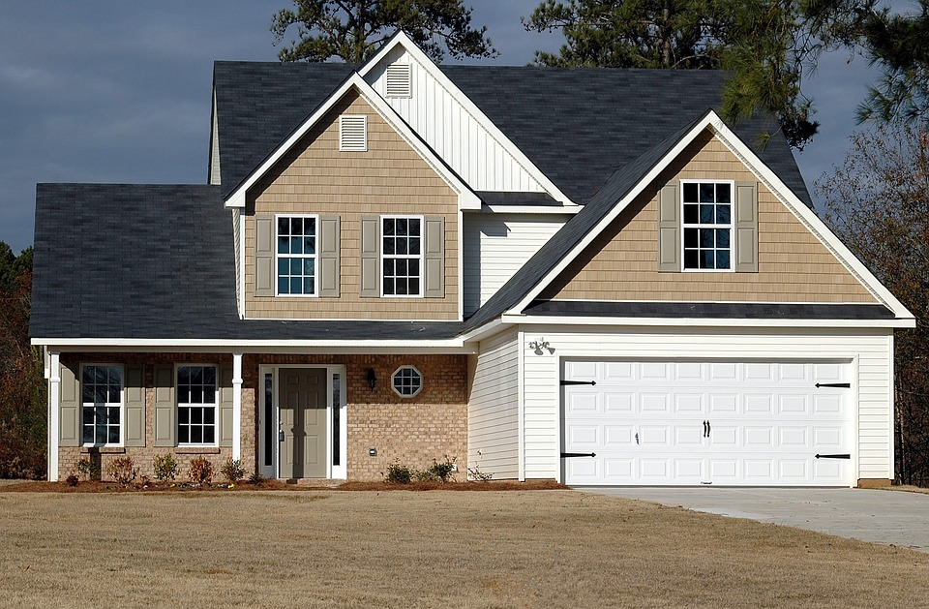

The acorn becomes the oak
How do we measure differences in time across same individuals?
Repeated measures
House at time 1
House at time 2
Intervention (install AC)
Notes:
OK, let’s take a look at another type of statistical test. In the last class we discovered that houses with AC have significantly higher average sales prices than those without.
A similar study would be to measure the sale price of homes without AC. Then install the AC. Then measure the sale price after the installation. This is called repeated measures because we are taking measures of the same observation at individual time points. There is often some intervention between the time points.
Now, in many settings, this is very difficult to conduct a repeated measures analysis, because it’s hard enough to measure these things once, let enough at multiple time points. Could you imagine buying a house, putting in AC, and then flipping it? That would be a very costly experiment with a lot of room for error.
But in some places like healthcare or education, where you are presenting new treatments or methods to your participants, and it’s likely you’ll be able to measure those participants at a later date, this is a common method.
So let’s get into one particular test related to repeated measures.

Slide 18
PAIRED SAMPLE T-TEST
Notes:
This is the paired-sample t-test. This is sometimes called the dependent samples t-test and, what do you know, it does have some relations to the independent samples t-test! This is the test we focused on in the last section.

Slide 19
ASSUMPTIONS
The data is paired
Independence of observations
The dependent variable is continuous
The data is continuous at times 1 and 2
Notes:
OK, so what are the assumptions here? First is that the data is paired. For each observation, we have a recorded observation for time 1 and time 2. If we do not have a recorded observation at each time point, we cannot use that record! And this test is to be used for when you have two time periods, if you have more, you use another test.
This test also assumes normality for each time point, similar to the independent samples t-test.

Slide 20
HYPOTHESES
Ho: No difference on average between time 1 and time 2
Ha: A difference on average between time 1 and time 2
Notes:
OK, our null hypothesis for this test is that there is no difference on average for our observations between time 1 and time 2.

Slide 21
DEMO
Demo: bp.xlsx
Is there a difference after the intervention?
Notes:
Cool, let’s take a look at an example, this one coming from the healthcare domain as many of these will. Here we have a patient intervention and we want to see if there is a significant difference in the blood pressures from time 1 to time 2.

Slide 22
DRILL
Demo: tomography.xlsx
For which groups is there a significant difference from volume 1 to volume 2?
Notes:
Now it’s your turn.

Slide 23
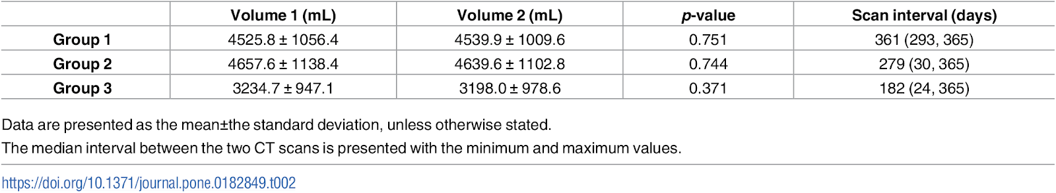
DRILL
Congratulations on replicating a research study!
Notes:
I took the above chart right from this research paper and we were able to get the exact results. Pretty cool! Congrats on replicating a research study.

Slide 24
QUESTIONS?
Notes:
Any questions on descriptive statistics?

Slide 25
ASSUMPTIONS
The data is paired
Independence of observations
The dependent variable is continuous
Notes:
These assumptions are pretty similar to the t-test with one very important difference, that we are no longer assuming normality in our data. This means we can no longer test for the difference in means, because we aren’t assuming that the distribution of our sample means is normal.

Slide 26
HYPOTHESES
Ho: The median difference between time 1 and time 2 is zero
Ha: The median difference between time 1 and time 2 is not zero
Notes:
Instead, we are going to look for the median difference and whether that’s equal to zero. We will rank-order the distances for each time point between 1 and 2, and between those differences determine whether if we’d expect the median difference is zero.

Slide 27
DEMO
Demo: cortisol.xlsx
Is there a difference in morning versus evening doses?
Notes:
OK , let’s go ahead and do that with this dataset, again from the healthcare space. We want to see if there is a difference among the same patients in cortisol measures in the morning versus the evening.

Slide 28
DRILL
Demo: rfft.xlsx
Is there a difference after the intervention?
Is there a significant difference in the number of perseverative errors drawn by the same participants from Measurement 2 to Measurement 3?
Higher secondary school
University
Lower secondary school
Measurement 1

Slide 29
QUESTIONS?
Notes:
Whew! That was a whirlwind. I hope that that helped you start thinking outside just being able to do independent samples t-tests, there is a whole world out there, and we will continue surveying it for the rest of the class!

Slide 30
2. WORKING WITH MULTIPLE GROUPS
Notes:
OK, now let’s continue on our medley of statistics. In this section, we will look at a way to compare the means of more than two groups. We will also look at how to analyze the linear relationship between two or more continuous variables, that will serve as the basis for our last section on linear regression.

Slide 31

EDA, PART DEUX
Notes:
But, first things first, the more and more advanced we get with these analyses and expand our repertoire it’s very tempting to want to cut corners by doing things like skipping the descriptive statistics. Don’t do this! We’ve already kind of done it in the last section, by not really looking for ourselves at the means and not graphing our relationships, but that ends now.

Slide 32
There’s ALWAYS room for descriptives!
Central tendency
Expected value = mean
Variability
Variance, standard deviation, range
Distribution
Skewness, kurtosis
Notes:
So, let’s remember
The expected value that’s what we were talking about before.
We also don’t want to forget about these other measures. OK Great.

Slide 33
Every picture tells a story
Visualizing distributions with histograms and box plots
Demo: iris-viz.xlsx
Notes:
We also want to keep visualizing our data. This may seem so unsophisticated to draw a picture, but we are visual creatures, we need to see a picture! So let’s look at a couple of ways to plot the distribution of a variable. The first will be familiar to you if you took the previous class, but let’s look at another way to visualize the data.

Slide 34
DRILL
File: abalone-viz.xlsx
Visualize the distribution of shucked_wgt by sex
Notes:
OK, now it’s your turn to plot these relationships.

Slide 35

COMPARING THE MEANS OF MORE THAN TWO GROUPS
Notes:
OK, so if you were thinking too many steps ahead of me, you may have thought, well, how are we going to test these differences across groups? Because with the t-test we were only able to test for differences between two groups? Well, that means it’s time for a new type of test! Get ready…

Slide 36
ANALYSIS
OF
VARIANCE
Notes:
This will be the analysis of variance, or ANOVA. As with the others that we’ve covered thus far, let’s walk through the assumptions and the hypotheses for this test.

Slide 37
ASSUMPTIONS
Subjects are randomly sampled
Observations are independent
Normality of each group
Population variance is equal for all groups
Notes:
OK, the first three should sound pretty familiar, we’ve got random, independent variables, this time we’ve got multiple groups, and they should be normal, fine.
The extra assumption we have is that the population variance is equal for all groups, we’ll see why that’s important in a minute here. It seems kinda weird that we are comparing means, but there is an assumption about variance, and it’s called the analysis of variance, what gives?

Slide 38
HYPOTHESES
Ho: No difference in population means of all groups
Ha: A difference in population means of all groups
Notes:
Here are our hypotheses, and these seem in line with what we’ve done before, right? There is no difference in the means across groups. Great.
So….

Slide 39

WHY ANOVA? WHY NOT ANOME?
Notes:
Why on earth is it the analysis of variance test? Shouldn’t it be the analysis of means test?

Slide 40
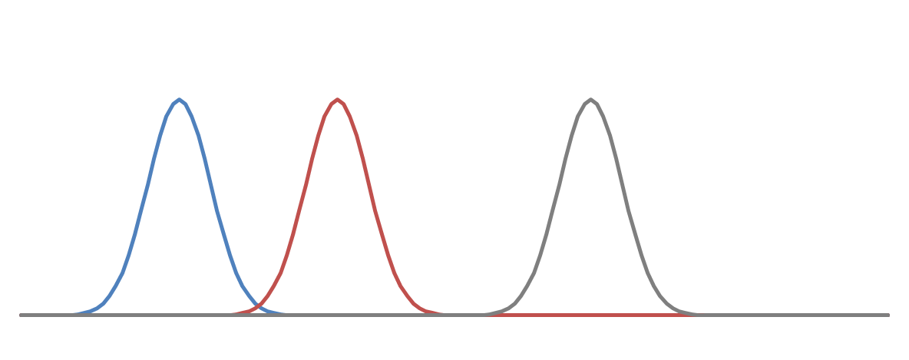
BETWEEN-GROUP vs WITHIN-GROUP
Grand mean
Total variance
Mean 1
Mean 2
Mean 3
Between-group variance
Within-group variance
Notes:
Well, the reason we call it the analysis of variance, is that we are using the variance to look for the difference in means. If you can imagine here that we have three groups, we can take the grand average of the groups. Now, for each of these groups, we can decompose the variance of that group into that shared with the other groups, and that variance exclusive to the group.
If we find that there is more within-group variance than between-group variance, then that means that there is a significant difference in means.
This is one of those charts that you may want to come back to later and it will click as you sit there and take your time with it.

Slide 41
DEMO
Demo: abalone-anova.xlsx
Is there a difference in shucked weight across all groups?
Notes:
OK, let’s do an example here using the abalone dataset. We have male, female and infant snails and we want to see if there is any difference across the groups.

Slide 42
DEMO
Demo: abalone-anova.xlsx
Is there a difference in shucked weight across all groups?
What pairs are actually different?
Pairwise t-tests
“Post-hoc”
Watch out for that p!
Experimentwise error
Notes:
Well we did that, and it looks like yes, there is a significant difference. But the interest thing about the ANOVA is we don’t actually know which groups are significantly different from each other. For that, we are going to have to compare pair by pair, which groups are higher or lower.
Now if this sounds to you like a bunch of t-tests, you are exactly right, that’s what we will do. These are called pairwise, because we are comparing each pair of the test at a time, you may also hear this procedure called a post-hoc test because we are doing it after the ANOVA proper.
But since we are doing so many of them, we need to be extra-careful in how we analyze our results, and that is due to the way p-values operate. Let’s take an example.

Slide 43

SOLD: $200,000
SOLD: $200,000
α = .05
If the null were true (i.e. no real difference in means), we would find a significant difference in 5% of our samples due to random error.
Notes:
Let’s take an example from our housing prices dataset. Let’s say that our null is there is no difference in sales prices for homes with our without air conditioning. If we did indeed live in this world, and we tested for significance at the 95% confidence level, then we would still find a significant difference in sales prices in 5% of our samples, due to random error.
That’s a 1 in 20 chance of finding a significant difference when there is none! So if we do a bunch of tests, the higher our chances that we will hit a significant finding due to random chance. This is called experimentwise error.

Slide 44
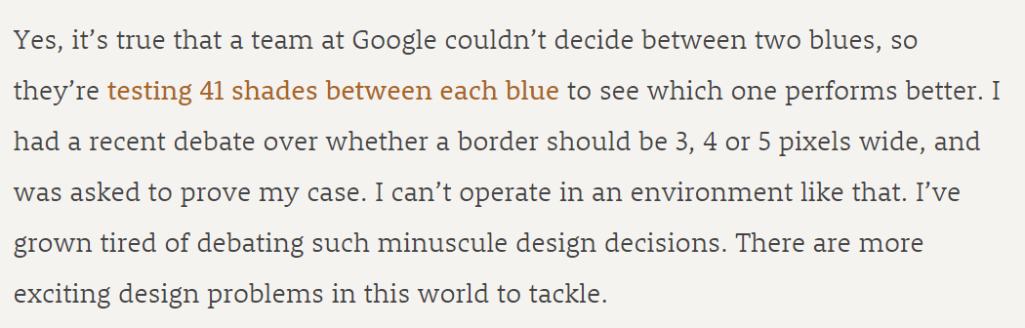
IT HAPPENS
https://stopdesign.com/archive/2009/03/20/goodbye-google.html
Notes:
Now it may sound unrealistic that this would be a real-life concern, that we would be making that may tests, but it really does happen! Here is a famous case study from Google where they tested between 41 different shades of blue to see which one performs better!
It would be very hard to know which ones are really more effective, not just from random error.

Slide 45
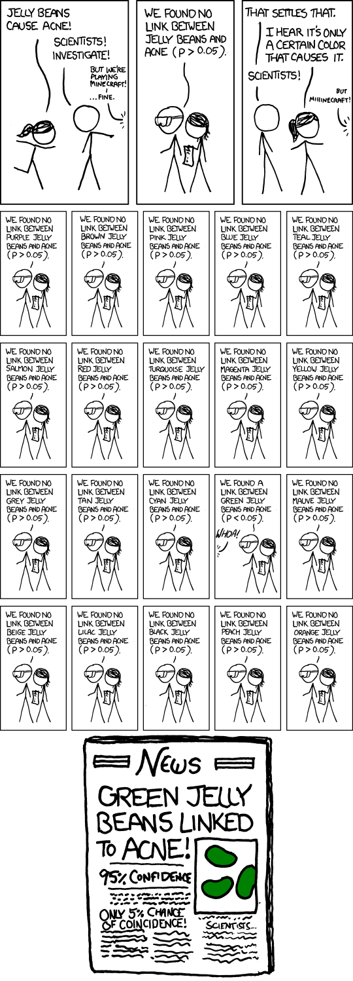
IT HAPPENS
https://xkcd.com/882/
Notes:
Here’s a humorous one from the comic X

Slide 46
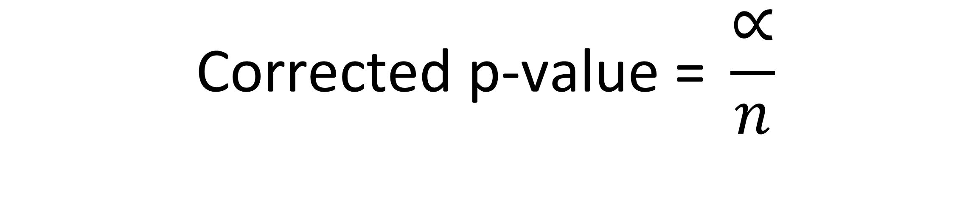
BONFERRONI CORRECTION
1 – confidence level (usually 5%)
$$\text{C}\text{orrected} \text{p}\text{−}\text{value}\text{ = }\frac{∝}{n}$$
Number of groups compared
Notes:
So there are lots of ways to adjust for this experimentwise error, when we are doing these post-hoc tests. Let’s do a common, relatively simple on, the Bonferroni correction. Here we will find a new p-value to compare our data to for significance. We will divide our current alpha, which will be 5% for us, by the number of groups compared.
This has the benefit of making our p-value lower.

Slide 47
DEMO
Demo: abalone-posthoc.xlsx
What groups are different? (Pairwise t-tests)
How do we adjust for experimentwise error? (Bonferroni correction)
Notes:
OK, let’s see this play out in action in our abalone dataset.

Slide 48
DRILL
iris-anova.xlsx
Is there a significant difference in petal lengths across groups?
Which groups?
Notes:
Now it’s your turn.

Slide 49
QUESTIONS?
Notes:
Any questions on ANOVA?
Now let’s look at a way to compare two or more continuous variables, this time rather than compare differences across groups, we will see how the variables trend to each other, linearly.

Slide 50
PEARSON CORRELATION
Notes:
This is correlation, we are going to do the Pearson correlation. As always let’s step through the assumptions and hypotheses.

Slide 51
ASSUMPTIONS
Two variables are normally distributed
Relationship between two variables is linear
No influential cases
Notes:
OK, in this case we still assume normality, nothing new there. A couple new ones though next. First is that we have a linear relationship between our two variables, you will see what that means as we get into the demos.
Another new one is that there should be no influential cases, this is similar to the concept of an outlier that you may be familiar with.
Because in this process we are looking for a pattern to extrapolate. If there are any individual observations that don’t fit that pattern, that will skew off the pattern.

Slide 52
HYPOTHESES
Use this rule of thumb for now:
Correlation coefficient | Interpretation
-1.0 | Perfect negative (linear) relationship
-.7 | Strong negative relationship
-.5 | Moderate negative relationship
-.3 | Weak negative relationship
0 | No (linear) relationship
+.3 | Weak positive relationship
.5 | Moderate positive relationship
.7 | Strong positive relationship
+1.0 | Perfect positive relationship
Notes:
Now, there is a way to write a formal hypothesis and test for the statistical significance of correlations, but for now let’s just focus on interpreting the raw “correlation coefficient” that is returned when you correlate two variables. This figure will go from -1 to 1 and it indicates the strength of the linear relationship between two variables.

Slide 53
Correlations
Demo: iris-corr.xlsx
Printing a correlation matrix
Visualizing a bivariate relationship: scatter plots
Notes:
OK, let’s take an example using the iris dataset. As with most statistical analyses, we will want to both crunch the numbers and draw a picture. These will both give us important context.

Slide 54
Every picture tells a story
Be careful about linearity!
Demo: anscombe.xlsx
Notes:
Now let’s take a moment to walk through an example of why it’s so important to draw a picture of your variables’ relationships. Let’s walk through the Anscombe dataset.

Slide 55
DRILL
mpg.xlsx
Produce a correlation matrix
What is the strength of the relationship between weight and acceleration?
Plot the relationship.
Notes:
OK, now that you see the importance of the matrix and the charts, go ahead and do a correlation matrix, and focus your attention on examining the relationship between weight and horsepower.

Slide 56
3. UP AND RUNNING WITH LINEAR REGRESSION
Notes:
All right! Final chapter. Let’s get into linear regression. You are going to see that while regression has its roots in correlation, the way it works is a little different.
You’ve probably all heard that correlation does not equal causation. Well, what does that mean? Let’s take a look right now.

Slide 57
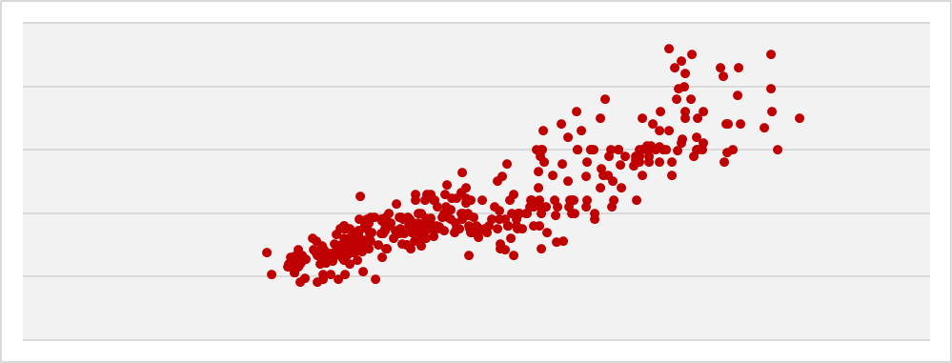
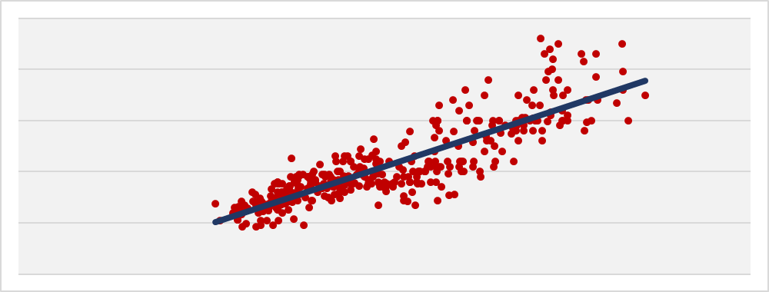
Correlation | Regression
Indicates the extent to which two variables move together linearly | Indicates the estimated impact of a unit change of the independent variable X on the dependent variable Y.
Notes:
OK. We now know that correlation measures the extent to which two variables move together linearly. And we drew that relationship with a scatter plot.
Now let’s do something a little different, we are doing to fit a line through that scatterplot. And this line will indicate how much we estimate a change in X will affect Y.
It’s a subtle difference, but they are different. So maybe take some time later today, just print out this slide, keep looking at it and it will click I think.

Slide 58
ASSUMPTIONS
Linear relationship between independent and dependent variable
No influential cases
Values of residuals are independent
Variance of residuals is constant
Values of residuals are normally distributed
Notes:
Ok, off to the assumptions like the other tests we’ve done. One is that there is a linear relationship between the variables, we had the same for correlation. Also, no influential cases. The other ones we won’t get into so much. They have to do with the residuals, which you will learn about in a bit.

Slide 59
EXPLICIT WARNING:
MATH AHEAD
Notes:
Brace yourselves! I want to show you the formula for the line that we are going to fit into our scatter plot.

Slide 60

LINEAR REGRESSION EQUATION
Independent / response variable
Slope coefficient
Error term
Dependent / predictor variable
Y intercept
$$Y_{i}=β_{0}+β_{1}{∗X}_{i}+ε_{i}$$
Notes:
Again, we are predicting Y with a straight line. This line will have three components – first is going to be the y intercept. Then we will find a coefficient of the slope multiplied by our independent variable.
Then there will be some random error. This is the variation in the dependent variable that our independent variable doesn’t explain.

Slide 61
HYPOTHESES
Ho: No relationship between X and Y. The slope equals zero.
Ha: A relationship between X and Y. The slope does not equal zero.
Notes:
Now, the hypotheses. Again, it’s all about this fitted line. If the slope of the line is equal to zero, we really can’t say how 1 unit of X influences Y.
Now, there is a series of steps, or an algorithm to use the fancy word, used to actually fit that line, but we will let Excel do it for us. And we will get something like the next slide.

Slide 62
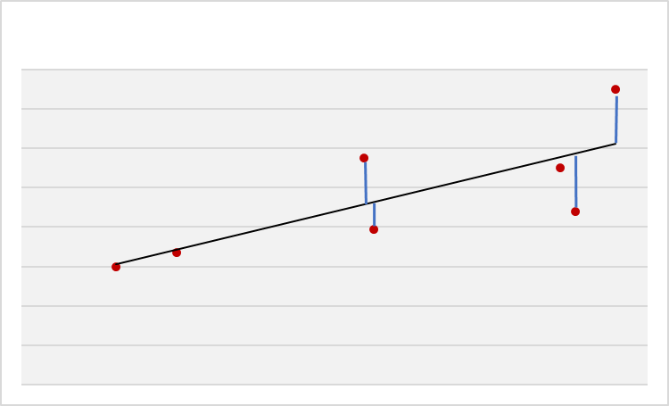
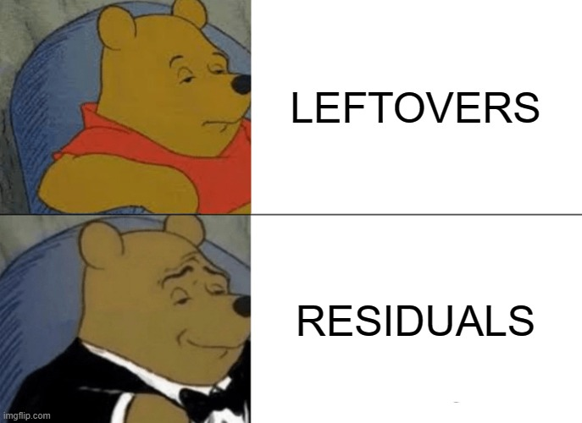

$$Residual=Y−\hat{Y}$$
Observed value
Estimated value
Notes:
Now, here is a pretty small scatter plot where we have fitted a line between these points. We have our actual points from the scatter plots, and the estimates based on where those X values fit on the line. This is the difference between the actual, and the estimated, and this is the residual. You can think of it as the leftover between the scatterplot and the line.

Slide 63
DEMO
mpg-regression.xlsx
Is there a significant relationship between weight (X) and acceleration (Y)?
Notes:
OK, that was a ton of information! Let’s walk through and do this in Excel.

Slide 64
DRILL
mpg-regression-drill.xlsx
Is there a significant linear trend between lot size and sale price?
Notes:
OK now it’s your term to do the same on another dataset that you should be pretty familiar with.

Slide 65
MODEL DIAGNOSTICS: R-SQUARE
Regression model
How much is explained here? This is r-square
Variability of Y
Error
This remains unexplained
Notes:
Great, now that you have used Excel to fit that line between X and Y, let’s take a couple of extra steps to interpret our model. We already saw from the p-value that the slope of our line is significantly different from zero. But this doesn’t tell us how much of Y is explained by X – for this, we will use r-square.
This goes back to the error term. Everything we can’t explain in y’s variability is error. The part we can explain is the R-square. R-square is based in a percentage amount. It’s there in our Excel output, so we’ll go back and interpret it.

Slide 66

MAKING POINT PREDICTIONS
$$\hat{Y}=β_{0}+β_{1}{∗X}_{i}$$
$$\hat{Y}=10+.5∗4$$
$$12=10+.5∗4$$
Notes:
Another thing we can do is use our fitted line to predict values of Y given an X value. This predicted value is indicated as y-hat. So, here’s the equation of our fitted line. Let’s say our Y-intercept was fit to 10 and the slope is .5.
If our estimated value of X is 4, then our predicted value of Y is 12.

Slide 67
DEMO
mpg-regression-diagnostics.xlsx
Locate and evaluate r-square
What is the predicted mpg for a car weighing 2,500 pounds?
Notes:
OK, let’s take our mpg regression model to the next level.

Slide 68
DRILL
housing-regression-diagnostics-drill.xlsx
Locate and evaluate r-square
What is the predicted sale price for a house with a lot of 2,400 square meters?
Notes:
Now it’s your turn.

Slide 69
QUESTIONS?
Notes:
We really just scratched the surface here with linear regression! But hopefully it gives you a sense of how it works. And really it’s so foundational to data analysis. It really bridges the gap between stats and data science.

Slide 70
4. CONCLUSION
Notes:
All right, we are at the end of our whirlwind tour! Here is some future learning for you and some things to check out on the O’Reilly learning platform.

Slide 71
Future learning
Continue exploring linear regression
Assumptions
Multiple regression
Regression with categorical variables
Logistic regression
Simulation and optimization
Notes:
Now, if you wanted to take your learning to the next level, here are some things to do.
First would be to get deeper into linear regression. We didn’t do much with things like removing outliers or examining the residuals. But you really want to get that stuff down.
We also only modeled a regression with one independent variable. You can have several and that’s called multiple regression. And those independent variables can even have categorical variables, for example you could use whether a car has some premium feature (yes or no) to predict its mileage.
Once you’ve got linear regression down, you can move onto logistic regression. Now this is a way to model the influence of independent variables on a binary dependent variable, such as whether a customer will buy or not buy.
Then you can get into simulation and optimization methods. These techniques are built on many of the statistical principles we’ve covered in this class and are very applied. They work great in Excel.

Slide 72
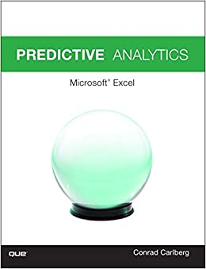
Predictive Analytics: Microsoft Excel, by Conrad Carlberg
On O’Reilly Learning at https://learning.oreilly.com/library/view/predictive-analytics-microsoft/9780134682921/
Human Centered Design • MDLS 2020
Notes:
Here is some further reading. Now that you’ve learned linear regression, you start to enter the realm of predictive analytics and this is a great book for that in Excel. It’s got some chapters digging in on linear regression as I suggested you do and then covers some other important topics.

Slide 73

Data Smart: Using Data Science to Transform Information into Insight,
by John Foreman
On O’Reilly Learning at https://learning.oreilly.com/library/view/data-smart-using/9781118661468/
Human Centered Design • MDLS 2020
Notes:
This is a more “modern” approach to statistical analysis in Excel and will show you techniques like clustering, naïve Bayes, and things that you might not have thought possible in Excel, but again by learning them in Excel you get a really hands-on look at how these algorithms work that you may not necessarily get in R or Python (I quoted from this book way at the beginning in explaining why we would want to learn this stuff in Excel!)
The final chapter of this book does show you how to move into R from spreadsheets which is not a bad idea when you want to “productionize” what you have learned, but spreadsheets are really an awesome learning tool.

Slide 74
LET'S TALK
LINKEDIN
linkedin.com/in/gjmount
EMAIL ADDRESS
george@stringfestanalytics.com
WEBSITE
stringfestanalytics.com
GITHUB
github.com/summerofgeorge
Notes:
Thanks for coming! Feel free to contact me anytime, find me on LinkedIn, I also write frequently on this stuff so check out my website too.

Slide 75
QUESTIONS?
Notes:
Any final questions?

